Slide 1
Data Modelling ?
ransactions,
Locking,
Blocking,
and Deadlocking
Transformation Functions
Aggregations and
Windowing
Common Table Expression (CTE)
Retrieving
Analytic Function
Data Definition
Language (DDL)
Error Handelling
Sorting
Subquery
Functions
Programming
Skills
Grouping and Summarizing
VIEW
SPs
Filtering
Querying from Multiple Tables
Triggers
Data Manipulation Language (DML)
PIVOT / UNPIVOT

Slide 2
Data Manipulation Language (DML)
Transactions and locking
Aggregation and Analytical Functions
Dynamic Query
Backup and Restoring
Retrieving
User Defined Functions
SQL SERVER AGENT
Sorting
Grouping and Summarizing
Subquery
VIEW
Error Handling
Introduction
Set up
Filtering
Transformation Functions
Querying from Multiple Tables
SPs
Programming
Skills
Data Definition
Language (DDL)
Triggers
PIVOT / UNPIVOT
Common Table Expression (CTE)
Query Performance Tuning
Principals and Users

Slide 3
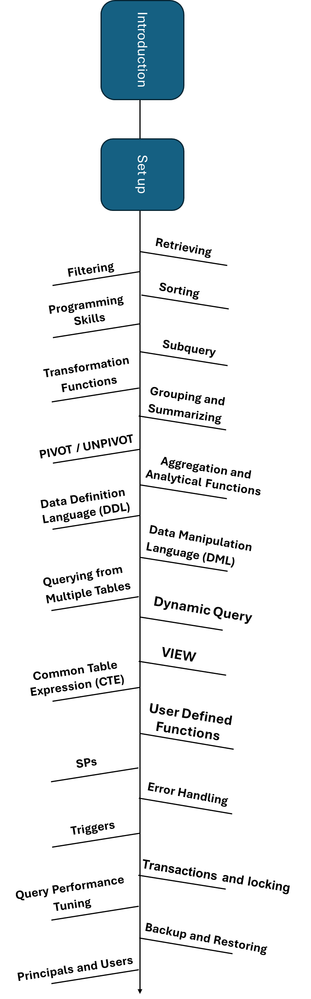
Download SQL SERVER
Download SSMS
Connecting to a Database
Load Data
Restore Backup
Select
Select * From
Select ColName1,ColName2,.. From
Renaming the Output Columns
Where
Operators
And / or / ()
Negating a Search Condition (! / not)
Specifying A Range of Values (between / not Between)
Checking for NULL Values
Providing a List of Values (in / not in)
Performing Wildcard Searches (Like)
EXISTS
Order By
Order by ColName1,ColName2,..
Order by 1, 2,..
Specifying Sort Order (ASC OR DESC)
Randomly Sort Orders (NEWID())
Unusual Sort Orders
Browsing a Result Set: OFFSET … FETCH …
ORDER BY (SELECT 1) OR ORDER BY (SELECT NULL)
SELECT TOP N SELECT TOP with ties
Declaring Variables
Retrieving a Value into a Variable
IF…THEN…ELSE Statement (EXISTS)
IIF
CASE Expression
WHILE Statement
Select * FROM (Subquery)
Character (String) Functions
Numeric Functions
Date Functions
Conversion Functions
Null Handling Functions
Group By / Distinct
Having
STRING_AGG
DISTINCT
Combination of Distinct and Count
Window Functions
- ROW_NUMBER()
- RANK()
- Dense_Rank()
- NTILE()
Analytic Function
- LEAD
- LAG
- First_Value
-Last_Value
Aggregation Function
Create
Alter
DROP
INNER JOIN
LEFT JOIN
Right JOIN
FULL JOIN
CROSS JOIN
INNER
Delete
Insert
Update
Merge INTO
Joins
UNION / UNION ALL
EXCEPT/ INTERSECT
Non-Recursive CTE
Recursive CTE
Scalar Functions
Table Functions
Inline Table-Valued Functions
Multi-Statement Table-Valued Functions
SQL SERVER AGENT

Slide 4
Sutup
Download SQL SERVER
Download SSMS
Connecting to a Database
Default database: master
Load Data
Restore Backup

Slide 5
Retrieving (Select)
Use statement
Retrieving all Columns
Retrieving Specific Columns
Renaming the Output Columns
TOP N
TOP wit ties
DISTINCT

Slide 6
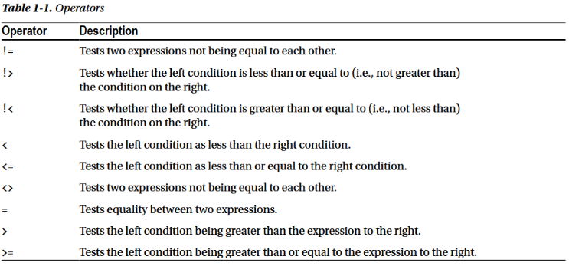
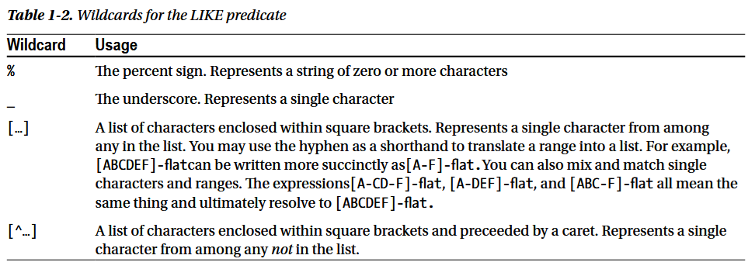
Filtering (Where)
Filtering: Specifying the Rows to Be Returned
Operators
And / or / ()
Negating a Search Condition (! / not)
Specifying A Range of Values (between / not Between)
Checking for NULL Values
Providing a List of Values (in / not in)
Performing Wildcard Searches (Like)
EXISTS

Slide 7
Sorting (Order by)
Order by ColName
Order by 1, 2,3
Specifying Sort Order (ASC OR DESC)
Randomly Sort Orders (NEWID())
Unusual Sort Orders
Browsing a Result Set: OFFSET … FETCH …
ORDER BY (SELECT 1) OR ORDER BY (SELECT NULL)

Slide 8
Programming Skills
Declaring Variables
Retrieving a Value into a Variable
IF…THEN…ELSE Statement (EXISTS)
IIF
CASE Expression
WHILE Statement
Going to a Label
Pausing Execution (WAITFOR DELAY / WAITFOR TIME )

Slide 9
Subquery
Subquery
The rules in subquery
SELECT TOP 100 .. FROM
SELECT TOP 100 Percent
SELECt TOP (@A) correct SELECT TOP @A Incorrect

Slide 10
Transformation Functions
Character (String) Functions
Numeric Functions
Date Functions
Conversion Functions
Null Handling Functions
CAST/ TRY_Cast
DATE
DATE / DATETIME / DATETIME2/ TIME
DATEADD / DATEDIFF / YEAR () / MONTH () / DAY () / QUARTEL
CONVERT
Right/ Left Function
AGGREGATE
CONCAT
ISNULL, NULLIF, COALESCE
Make a new Column: Combine Two Tables Building a Column from an Expression (+ , Concat)
CONCAT / +
DIG + DIG
STR + DIG
STR + STR
* / + -

Slide 11
Grouping and Summarizing
Having
STRING_AGG
DISTINCT
Combination of Distinct and Count

Slide 12
Querying from Multiple Tables
Join
INNER JOIN
LEFT JOIN
Right JOIN
FULL JOIN
CROSS JOIN
(
ON is equivalent with Where / NULL VALUES as Join Key
)
UNION/UNION ALL
EXCEPT/INTERSECT

Slide 13
Data Modelling
INDEX / HIP TABLE / Clustered / Non-Clustered Index

Slide 14
Data Definition Language (DDL)
CREATE
(Variable / TABLE Variable)
Sharp Table
#T
Difference Between #T and ##T
IDENTITY and SELECT * into #t from T1 (Transfer of Identity fom T1 to #T) How to avoid
Further data into #T using Insert
SELECT * FROM tempdb.sys.tables where name like ‘%temp%’
Identity(int,1,1) AS RW,. Into #Temp From ….
Alter
DROP
RENAME
TRUNCATE(Truncate does not work on Header Table. The Table should be detailed )

Slide 15
Data Manipulation Language (DML)
Insert
INSERT / Batch INSERT / BULK INSERT
Default Value
Overriding an IDENTITY Column
SET IDENTITY_INSERT
SCOPE_IDENTITY
Go INSERT …. GO (100)
Update
What is Update (Syntax)
Simultaneously UPDATE two columns
Loop-back Update
UPDATE RULES (By Changing the Header Table What Happened for Detail Tables)
No Action
SET NULL
SET Default
Cascade (Not Used for Delete) for Update It can be used
Delete
Merge

Slide 16
Aggregations and Windowing / Analytic Function
Window Functions
ROW_NUMBER()
RANK()
Dense_Rank()
NTILE()
Analytic Function
LEAD
LAG
First_Value
Last_Value

Slide 17
Functions
Functions
Scalar Functions
Table Functions

Slide 18
Supplementary Materials

Slide 19
Providing Shorthand Names for Tables

Slide 20
Language | Meaning | Controls
DDL | Data Definition | Structure
DML | Data Manipulation | Data changes
DQL | Data Query | Data retrieval
DCL | Data Control | Security
TCL | Transaction Control | Integrity

Slide 21
paymentID | orderID | …
Payment
Delivery
Order_Items
deliveryID | orderID | …
orderItemID | orderID | productID | …
Order
orderID | customerID | …
Invoice
InvoiceID | orderID | …
Product Specification
Customer
specID | productID | …
customerID | …
Address
Inventory
addressID | customerID | …
Product
inventoryID | productID | warehouseID | …
productID | categoryID | …
Category
Warehouse
categoryID | …
warehouseID | …

Slide 22
paymentID | orderID | …
Payment
Delivery
Order_Items
deliveryID | orderID | …
orderItemID | orderID | productID | …
Order
orderID | customerID | …
Invoice
InvoiceID | orderID | …
Product Specification
Customer
specID | productID | …
customerID | …
Address
Inventory
addressID | customerID | …
Product
inventoryID | productID | warehouseID | …
productID | categoryID | …
Category
Warehouse
categoryID | …
warehouseID | …

Slide 23
sales.Payment
core.Product Specification
paymentID | orderHeaderID | …
specID | productID | …
Shipping.Delivery
deliveryID | orderHeaderID | …
orderHeaderID | customerID | …
sales.OrderDetail
core.Product
orderDetailID | orderHeaderID | productID | …
productID | categoryID | …
sales.Invoice
sales.orderHeader
InvoiceID | orderHeaderID | …
core.Customer
customerID | …
core.Category
categoryID | …
inventory.Inventory
inventoryID | productID | warehouseID | …
core.Adresse
addressID | customerID | …
Inventory.Warehouse
warehouseID | …

